Slide 1
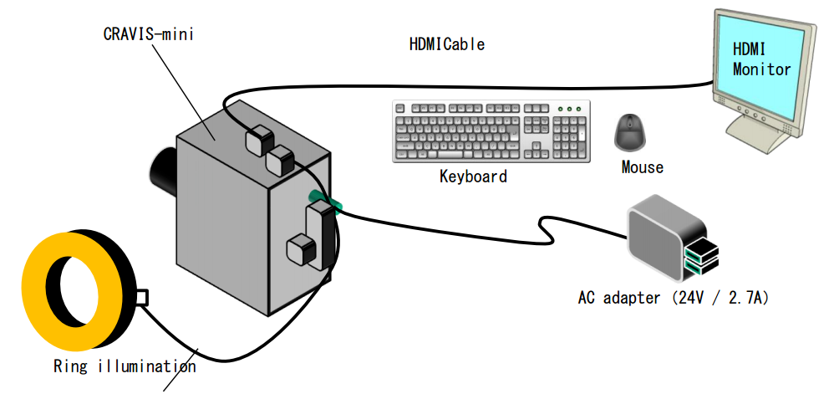
Rubber Check Investigate Result
(Using Cravis mini)
I
Overview
II
Investigate result
III
Next plan
IV
Schedule
PIC : Visual Group
Dept: AED

Slide 2
I. OVERVIEW
1.1. Cravis overview
Hardware
Cravis mini
Computer equipment
PiCamera
Power
Lighting system
Monitor
Mouse
Key Board
650$
200$
Software
Compiler
Python
Algorithm
Auto system
External Signal
Note : Cravis can connect 3 Camera ( 1 Pi Camera + 2 Web Camera )

Slide 3
I. OVERVIEW
1.2. Rubber Project
Purpose of project
Check direction of rubber
Combine with others units ➔ Auto system
Target : Auto check after assembly
New strategy : Using Cravis mini to check
Concept
1
2
3
4
Lamp
Roller
Pi Camera
Rubber

Slide 4

I. OVERVIEW
1.2. Rubber Project
Concept
Pi Camera
100-300 mm
Cycle time of machine : 6s/pcs
Time check of Cravis : 3s/pcs
$${90}^{0}$$
50-200 mm
Pi Camera
50-200 mm
50-300mm

Slide 5
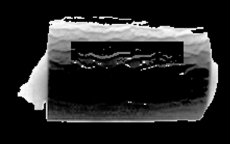
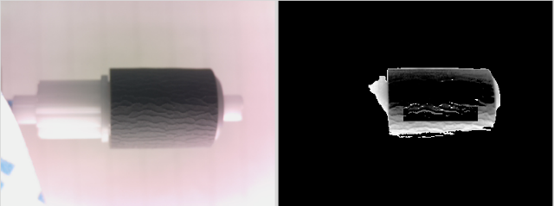
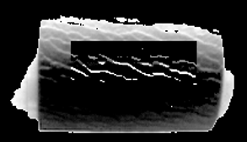
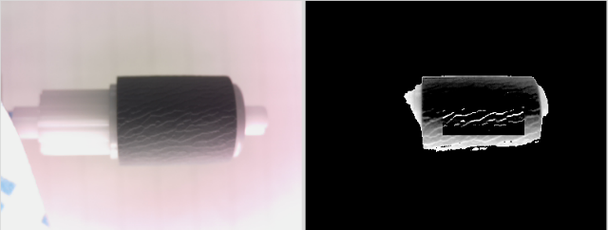
II. INVESTIGATE RESULT
2.1. Algorithm for checking
Extract Color ( Filter Color )
White Balance
Particle (Using to searching abnormal points)
0
255
Average – threshold
Average
Average + threshold
Convert to black
Keep color
Convert to white
OK
Count Pixel
OK pcs : 32- 75 (pixel)
NG pcs : 140-325 (pixel)
Threshold : (Max(OK)+Min(NG))/2
NG
! This is only Test Data (investigate room)

Slide 6
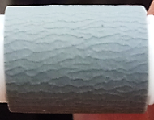
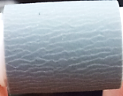
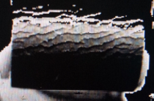
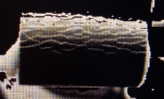
II. INVESTIGATE RESULT
2.2. Result (500pcs)
Sample Item check | Picture
 | OK sample(100) | NG sample(400)
Origin
Analyzed
Check Result | 100% OK (Count pixel : 32-75) | 100% NG (Count pixel : 140-325)
Detect 100%
! This is only Test Data (investigate room)

Slide 7
III. NEXT PLAN
3.1. Current system
Good point
Hardware : small → easy to layout
Software :
same with EOS program → familiar
same with industrial Camera Program
→ simple, convenient, easy make new program and setup spec file
Blur
Communication : connect with PLC is easy (I/O signal , Ethernet)
Need improve point
Program : simple →Need add more algorithms
Only check simple function →Improve to check complex function
3.2. Next plan
Test with many project
3.2.1 PCB
3.2.2 MOLD
3.2.3 ASSY

Slide 8
IV. SCHEDULE
Work content | Mar |  |  |  |  |  |  |  |  |  |  |  |  |  |  |  |  |  |  |  |  |  |  |  |  |  | Apr
 |  | 7 | 8 | 9 | 10 | 11 | 12 | 13 | 14 | 15 | 16 | 17 | 18 | 19 | 20 | 21 | 22 | 23 | 24 | 25 | 26 | 27 | 28 | 29 | 30 | 31
Test rubber (500 pcs) |  |  |  |  |  |  |  |  |  |  |  |  |  |  |  |  |  |  |  |  |  |  |  |  |  |  | PCB
Short report
Setup in line
Take Data
Debug
Test 1st
Test 2nd
Test 3rd
Apply

Slide 9
Thanks you for your attention
and valuable questions

Slide 10
➂ VISUAL INSPECTION SOFTWARE
Particle detect:
Purpose: Using to searching abnormal points
3 Variable: Window area, color, threshold
Example::
window area = 3 (3x3), color = 1, threshold =
100
95
100
100
95
100
Threshold = 14
105
100
110
105
100
110
90
100
100
90
100
100
R < average – threshold/2
R > average + threshold/2
Average =100
100
95
100
Threshold = 6
(Average – threshold/2) < R < (Average + threshold/2)
105
100
110
90
100
100

